Slide 1


APPLIANCES ENERGY PREDICTION
Presented by:
Vinay Kapeesh Varma Gottumukkala
MN46650

Slide 2

OVERVIEW
01
02
03
INTRODUCTION
APPROACH
DATA SUMMARY
04
05
06
DATA ANALYSIS
PREDICTIONS
INSIGHTS

Slide 3
INTRODUCTION
In this time of global uncertainty, world needs energy and in increasing quantities to support economic and social progress and build a better quality of life, especially in developing countries. But even today there are many regions which face constant power outages. These outages are primarily caused due to excess load consumed by home appliances.
Hence, the ability to predict energy consumption can not only save money for end user but can also help in generating money by giving excess energy back to Grid (in case of solar panels usage). In this project, I perform regression analysis in order to predict appliance energy usage based on data collected from various sensors.

Slide 4




APPROACH
Appliance Energy Prediction
01
DATA IMPORT
02
DATA CLEANING
03
DATA MODELLING
04
PERFORMANCE ANALYTICS

Slide 5
DATA SUMMARY
SHAPE
COLUMNS
Rows: 19735
Columns: 29
Various sensors data like temperature, pressure, and windspeed, visibility etc.
DUPLICATES AND NULL VALUES
OUTLIERS
None
Data contains outliers out of which 5% have been removed during data cleaning.

Slide 6
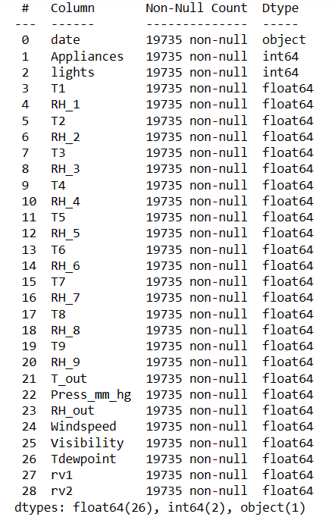
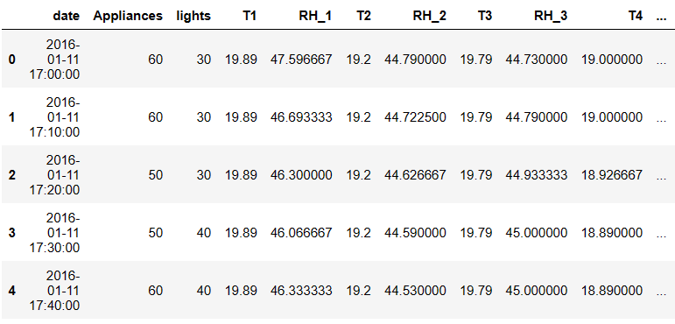

Slide 7

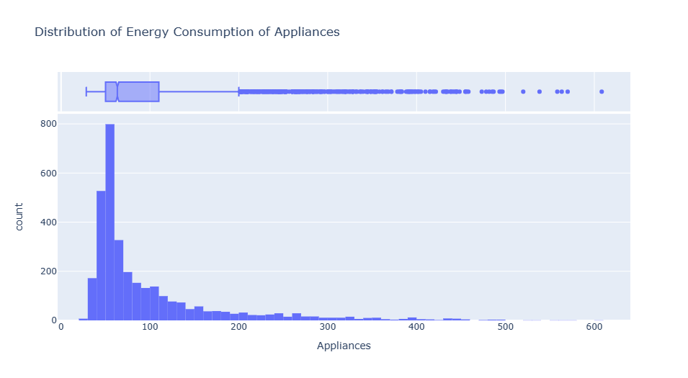
DATA ANALYSIS

Slide 8
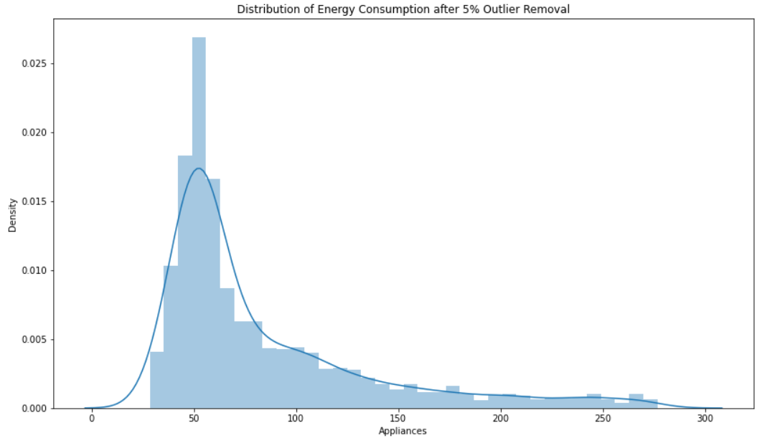
DATA ANALYSIS

Slide 9
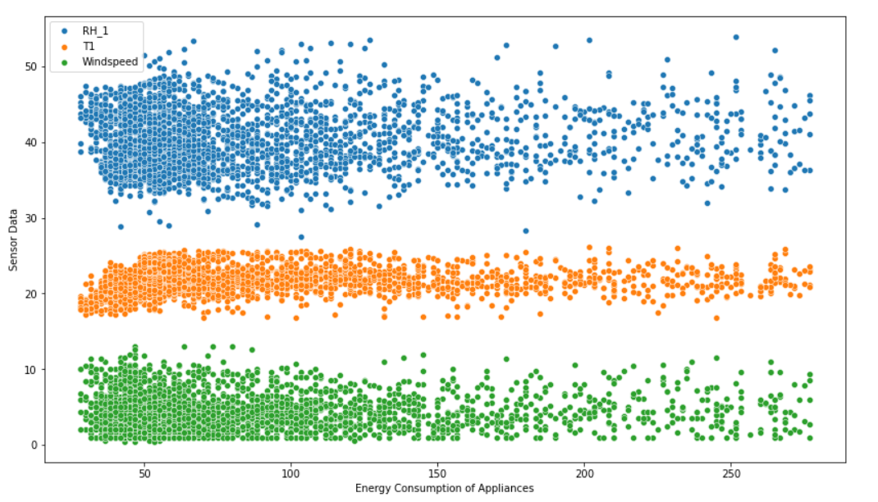
DATA ANALYSIS

Slide 10
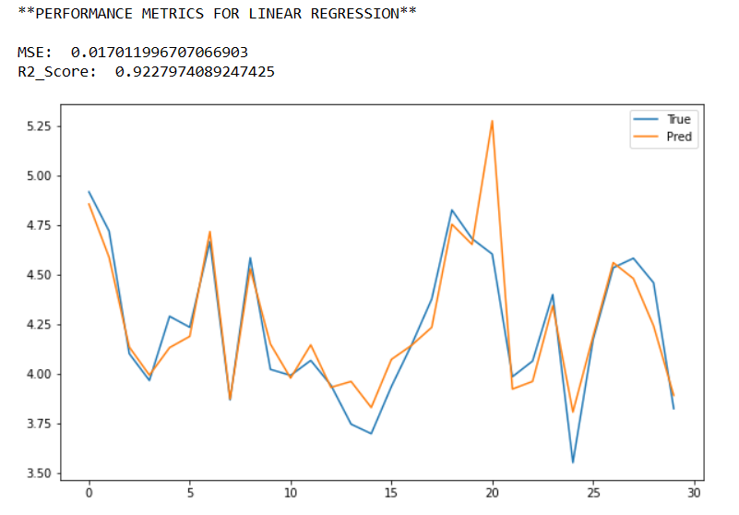
PREDICTIONS

Slide 11
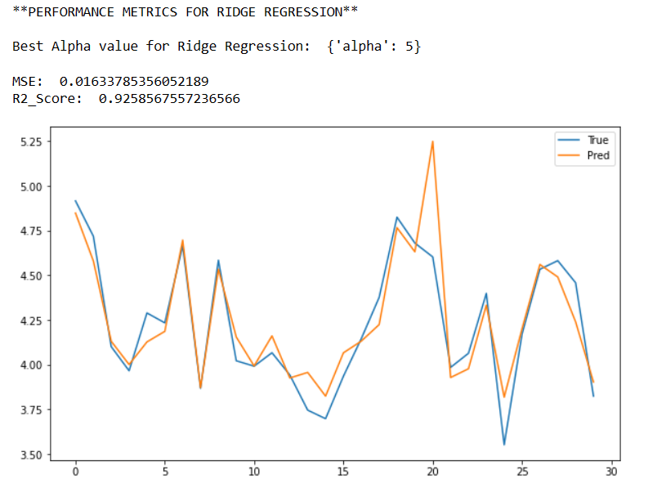
PREDICTIONS

Slide 12
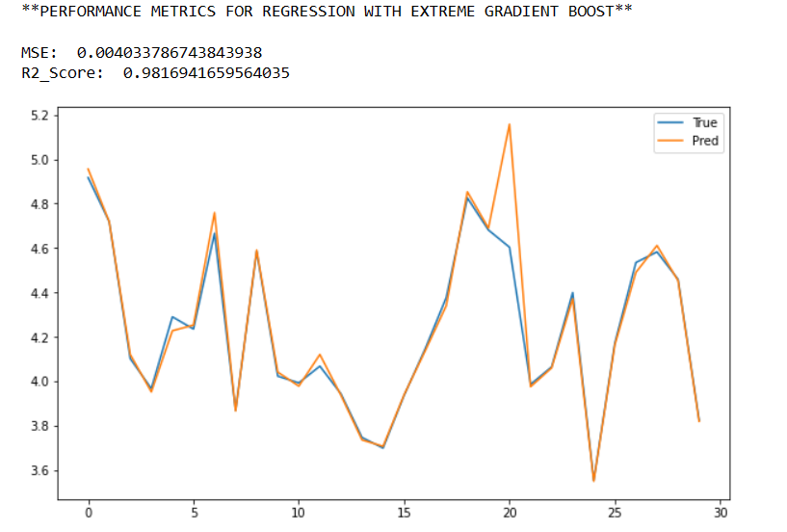
PREDICTIONS

Slide 13
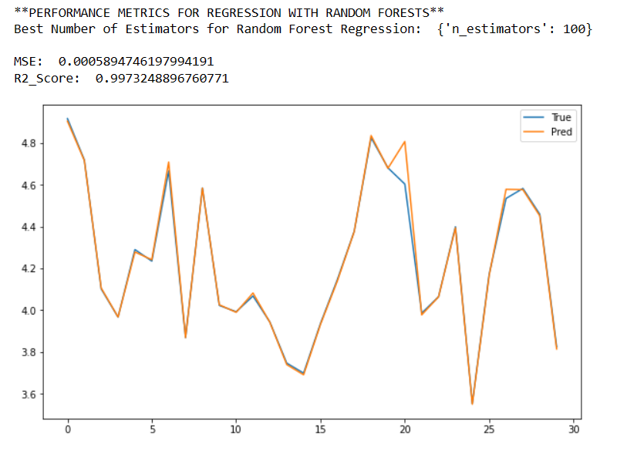
PREDICTIONS

Slide 14



INSIGHTS
Weekends (Saturdays and Sundays) are observed to have higher Energy consumption than Weekdays.
Energy consumption is higher during evenings.
Random Forest Regressor (with n_estimators = 100) has the most efficient performance metrics (MSE = 0.0005, R2_Score = 0.99) among the different models used in this prediction.

Slide 15
THANK YOU

